Slide 1
CHAPTER 10
Intercultural Conflict

Slide 2
Intercultural Conflict
“Defined as the experience of emotional frustration or mismatched expectations between individuals from different cultures who perceive an incompatibility between their values, norms, goals, scarce resources, or outcomes during an intercultural exchange.”
Ting-Toomey & Oetzel

Slide 3
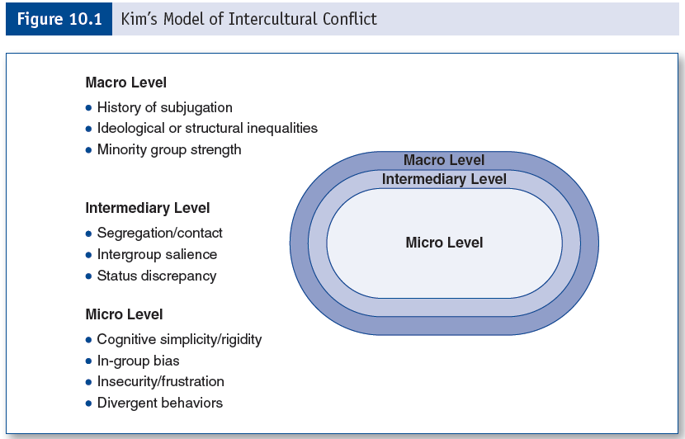
Kim’s Model of Intercultural Conflict

Slide 4
Face
Face—a person’s sense of favorable self-worth or self-image experienced during communicative situations.
Emotional extension of self-concept
A universal concept
Face Negotiation Theory—explains how people of different cultures manage conflict.

Slide 5
Facework
Facework—the communicative strategies employed to manage one’s own face or to support or challenge another’s face.
Can be used to initiate, manage, or terminate conflict.
Facework strategies:
Dominating
Avoiding
Integrating

Slide 6
Conflict Communication Styles
Avoiding
Dominating
Obliging
Compromising
Third-party help
Emotional expression
Neglect
Integrating

Slide 7
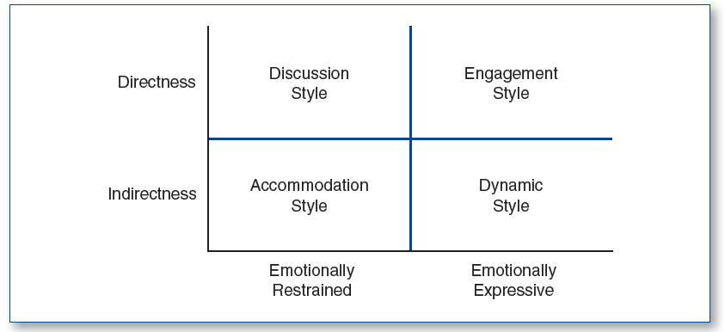
Intercultural Conflict Style

Slide 8
Individualist vs. Collectivism in Conflict
Individualists are outcome oriented in conflict.
Individualists become frustrated when feelings aren’t asserted honestly.
Conflict is perceived as productive when tangible resolutions are reached.
Collectivists are process oriented in conflict.
Conflict is perceived as threatening when substantive issues are addressed before facework management.
Conflict is perceived as unproductive when face issues and group feelings are not addressed properly.

Slide 9
Context and Conflict
Low-context cultures are more direct and explicit in conflict.
Separate conflict from the individual.
Prefer a solution-oriented stye.
High-context cultures are more indirect and implicit in conflict.
Connect conflict with the individual.
Prefer a non-confrontational style.

