Slide 1
CHAPTER 11
Intercultural Communication in Organizations

Slide 2
Intercultural Management
U.S. business face a multicultural population and work-force, as well as a globalized economic system.
There is no culture-free theory of management.
Includes such issues as: perceptions, building trust, respect, as well as behavioral rules regarding time, communication, etc.

Slide 3
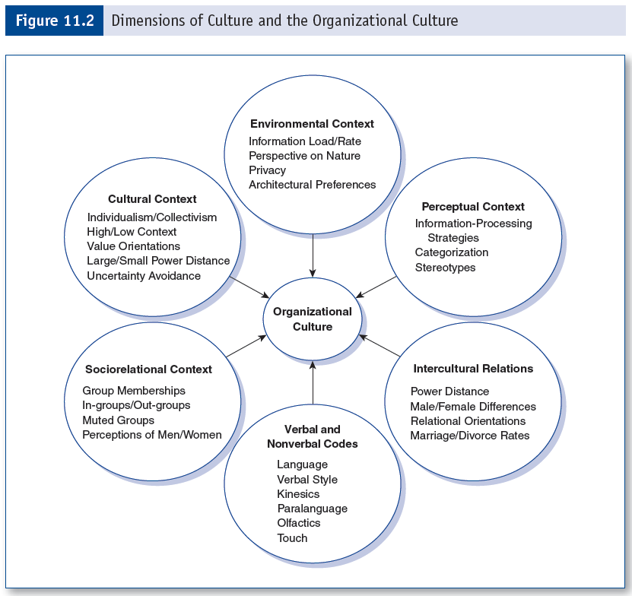
Dimensions of Culture and Organizational Culture

Slide 4
Power Distance & Organizations
Characteristics of large power distance cultures:
Status conscious
Employ top-down communication
Mindful of employee welfare
Employees not expected to participate in decision making.

Slide 5
Environmental Context
A culture’s perspective on nature is often translates into its organizational practices.
Collectivistic cultures tend to prefer working together in the same physical location.
Where physical privacy is not possible (e.g. Korea), psychological privacy is utilized.

Slide 6
Perceptual Context
Perceptions of American business practices:
Many Muslim countries dislike the U.S.
Some traditional allies (e.g. Canada) have a low opinion of the U.S.
India has most favorable opinion of U.S.
Russia has a more favorable opinion than a decade ago.
Characteristics mentioned in association with the U.S.: greedy, violent, immoral, rude, hardworking, and inventive.

Slide 7
Socio-Relational Context
Family corporation culture
A metaphor for organizations
Characteristics
Personal
Face-to-face communication
Hierarchical
Rewards
Pleasing elders
Sanctions
Loss of affection
Loss of role in the “family”

Slide 8
Verbal Communication
Seven deadly sins of international misunderstanding:
Local color
Jargon
Slang
Officialese
Humor
Vocabulary
Grammar

Slide 9
Japanese Management Practices
Shushin koyo (lifetime employment)
Nenko joretsu (seniority grading)
Moving toward performance-based grading
Taiso (morning exercise)
Feeling-based cognitive style of decision making

Slide 10
German Management Practices
Facts more important than face
Factual honesty more important than politeness
State-regulated apprentice system
Compartmentalization
Leadership positions awarded with time and experience (practicality) over academic degrees

Slide 11
Mexican Management Practices
Not rewarded with initiative, or self-determinism
Employers do not show favoritism
View work as a “necessary evil”
Organizations considered paternalistic
Value cooperation over competition
Top positions inherited or acquired through mutual favors/friendship
Rigid hierarchy
Innovative/risk taking behavior is inappropriate

Slide 12
Chinese Management Practices
Business practices guided by Confucian ideals
Relationships viewed as unequal
No separation between social and organizational relationships
Management is responsible for decision making
Organizational conflict dealt with through mediation and compromise
Gift giving

Slide 13
Middle East Business Practices
National development and industrialization are top priorities
Cultural discontinuity
Growth of economy is rapid
U.S. very unknowledgeable about middle east business practices, including names and titles

