Slide 1
CHAPTER 12
Acculturation, Culture Shock, and Intercultural Competence

Slide 2
Acculturation
The process whereby you adapt to a new culture by adopting its values, attitudes, and practices.
Factors to bring cultures together:
Mobility
Voluntariness
Permanence
Acculturative stress—the anxiety and stress associated with acculturation.

Slide 3
Model of Acculturation
The culture influences the individual, and the individual influences the culture
Acculturation of an individual influenced by:
Communication
Environment
Competence
Host receptivity
Host conformity pressure, etc.

Slide 4
Modes of Acculturation
Assimilation
Integration
Separation
Marginalization
Cultural transmutation

Slide 5
Culture Shock
The effects associated with the tension and anxiety of entering a new culture, combined with the sensations of loss, confusion, and powerlessness resulting from the forfeiture of cultural norms and social rituals.

Slide 6
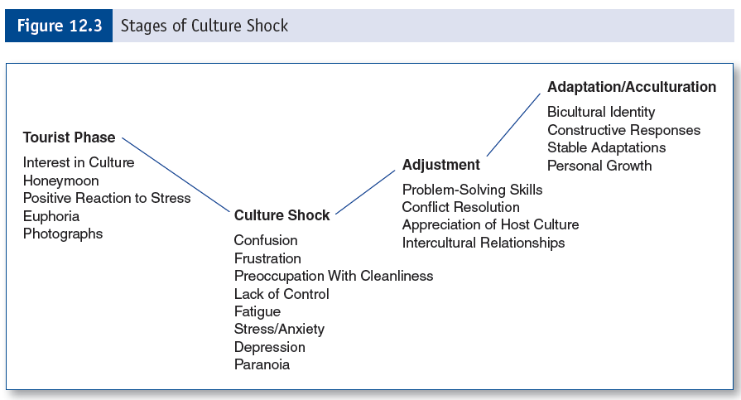
Model of Culture Shock

Slide 7
W Curve of Culture Shock
Contains two of the U curves of the culture shock model
Includes re-entry shock
Makes communication of cross-cultural experiences difficult to share
Generally, culture shock takes approximately one year

Slide 8
Model of Intercultural Communication Competence
Knowledge component—at minimum, a comprehension of values and beliefs.
Influenced by:
Cognitive simplicity and rigidity
Ethnocentrism

Slide 9
Model of Intercultural Communication Competence
Affective component—motivation to interact with those from other cultures.
Influenced by:
Intercultural communication apprehension
Intercultural willingness to communicate

Slide 10
Model of Intercultural Communication Competence
Psychomotor component—enactment (skill) of the knowledge and affective components.
Elements:
Verbal and nonverbal performance
Role enactment

Slide 11
Model of Intercultural Communication Competence
Situational Features—competence varies in situations and contexts.
This is dependent upon:
Environment
Previous contact
Status differential
Third-party interventions

Slide 12
Integrated Model of Intercultural Competence
Empathy
Intercultural experience/training
Approach tendencies
Global attitude
Listening skills

