Slide 1
CHAPTER 1
The Necessity of Intercultural Communication

Slide 2
Benefits of Intercultural Communication
Healthier communities
Increased commerce
Reduced conflict
Personal growth through tolerance

Slide 3
Eight Properties of Communication
Process -- ongoing
Dynamic -- changing
Interactive-Transactive – two-way exchange
Symbolic – learned symbol for representation
Intentionality – both intentional & unintentional
Contextual – context typically defines meaning
Ubiquitous – present everywhere
Cultural – profoundly shapes communication

Slide 4
Communication
The simultaneous encoding, decoding, and interpretation of verbal and nonverbal messages between people.

Slide 5
Communication Apprehension (CA)
The fear or anxiety associated with either real or anticipated communication with another person or group of persons.

Slide 6
Four Types of Communication Apprehensions
Personal Trait – personal predisposition affecting about 20% of American adults.
Context based – Only in some situational contexts such as public speaking, group meetings, job interviews.
Audience based – eg. Strangers, superiors.
Situational – context & audience, eg. with a professor in her office.

Slide 7
Culture/Cultural Patterns
Culture is used to refer to accumulated pattern of values, beliefs, and behaviors, shared by a group of people with a common history, using verbal and nonverbal symbol systems.
Culture is ubiquitous.
Culture is invisible yet pervasive.
Cultural programming provides the basis for values, beliefs, and behaviors.

Slide 8
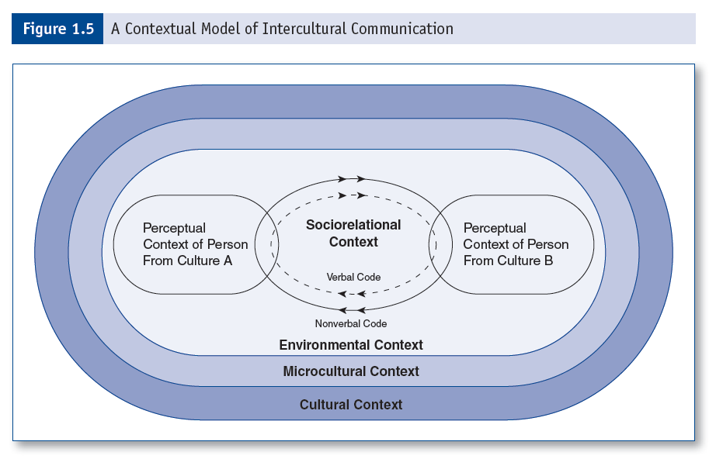
A Contextual Model of Intercultural Communication

Slide 9
Contexts
Cultural – macro influences, eg. national culture
Microcultural – subgroups, eg. Mexican American, women, immigrants, Muslims, LBGT, etc.
Environmental – physical locations, church or football game, etc.
Perceptual – each interactant’s cognition, attitudes, dispositions, motivation, etc.
Sociorelational – interactants’ relationship.

Slide 10
Fundamental Assumptions about Intercultural Communication
#1: During intercultural communication, the message sent is usually not the message received.

Slide 11
Fundamental Assumptions about Intercultural Communication
#2: Intercultural communication is primarily a nonverbal act between people.

Slide 12
Fundamental Assumptions about Intercultural Communication
#3: Intercultural communication necessarily involves a clash of communicator style.

Slide 13
Fundamental Assumptions about Intercultural Communication
#4: Initial intercultural communication is a group phenomenon experienced by individuals.

Slide 14
Fundamental Assumptions about Intercultural Communication
#5: Intercultural communication is a cycle of stress and adaptation.

Slide 15
Ethical Approaches for Assessing Human Conduct
Utilitarian Emphasis – conduct acceptable if good outweighs evil.
Personal Rights Emphasis – individual’s right to choose is emphasized.
Fairness Emphasis – conduct acceptable if everyone treated similarly.
Common Good Emphasis – actions should contribute to the community good.
Virtues Emphasis – certain virtues should guide behavior.

Slide 16
Other useful concept
Xenophobia: An unreasonable fear or hatred of foreigners or strangers or of that which is foreign or strange.

Slide 17
Other Useful Concept:
Ethnocentrism:
1. The belief in the inherent superiority of one’s ethnic group or culture.
2. A tendency to judge other groups or cultures from the perspective of one’s own.

