Slide 1
CHAPTER 2
The Cultural Context

Slide 3
Culture: * Is not innate, but learned. * Provides overall framework for humans organize thoughts, emotions, behaviors. * Teaches one how to think, feel, act, and interact with others.

Slide 4
5 Dimensions of Cultural Variability
Individualism --- Collectivism
Low-Context --- High-Context
Value Orientations
Power Distance
Uncertainty Avoidance

Slide 5
I. Individualism—Collectivism
How do individuals perceive themselves?
“I am distinct and unique” vs. “I am a member of a family”
How do individuals relate to others?
“What do I gain?” vs. “How will this affect others?”
What goals do they follow?
“I want to win” vs.“I am a team player helping the group win”
What drives their behavior?
“It is my right to do this” vs. “My duty is to my group”

Slide 6
II.High-Context vs. Low-Context
Restricted code
Silence is valued
Indirect, implicit messages
Examples: China, Vietnam, and many African cultures.
Elaborated code
Silence is uncomfortable
Direct, explicit messages
Examples: the U.S., Switzerland, and France

Slide 7
III.Value Orientations (Condon & Yousef p. 73)
Individual/Low Context vs. Collectivistic/High Context in terms of:
The self
The family
Society
Human nature
Nature
The supernatural

Slide 8
IV. Power Distance
“The extent to which the less powerful members of institutions and organizations within a country expect and accept that power is distributed unequally.” –Hofstede

Slide 9
Power Distance & Facework
Face is what others think of oneself, or one’s image.
Self-face: Concern for one’s own image.
Other-face: Concern for other’s image.
Mutual-face: Concern for both own and other’s image.

Slide 10
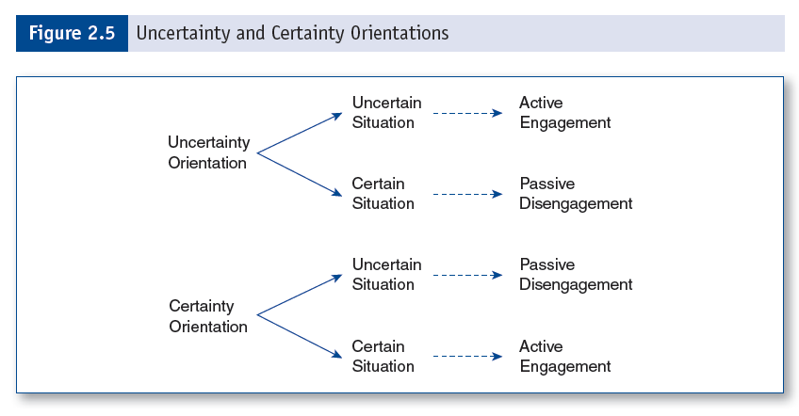
V. UNCERTAINTY AVOIDANCE The degree to which the members of a particular culture feel threatened by uncertain or unknown situations.

