Slide 1
CHAPTER 4
The Environmental Context

Slide 2
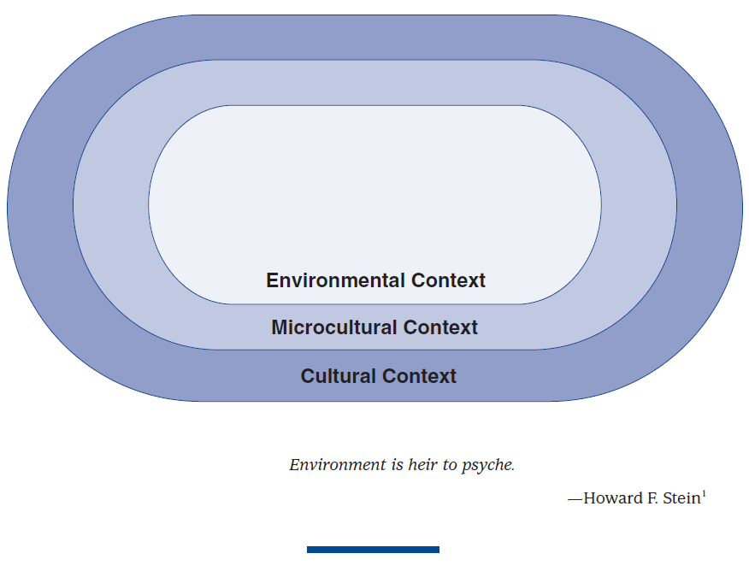
* How humans perceive the physical environment is very much affected by their culture and microculture, even though this influence is generally outside their conscious awareness. * People from all cultures project their mental perceptions onto the physical environment and act as though what is projected is, in fact, the true quality of the physical world.

Slide 3
Environments & Information Load
Information Rate: The amount of information contained or perceived in the environment per unit of time.
High Load: Uncertain, complex, dense, random, improbable
Low Load: Certain, simple, sparse, patterned, probable

Slide 4
Information load affects feelings in three ways:
Arousal vs. Nonarousal (level of stimulation)
Pleasure vs. Displeasure (degree of satisfaction)
Dominance vs. Submissiveness (control of situation)

Slide 5
Three Orientations towards Nature
Omnipotent Nature: Nature perceived as a dominant and unmanageable power.
Humans in Harmony with Nature: Nature perceived as orderly and cyclical. People and environment are one, changing together.
Humans Controlling Nature: People not part of environment. Nature to be controlled, harnessed, and subjugated for human benefit.

Slide 6
Built Environment:
Of any culture consists of any adaptations to the terrestrial environment, including architecture, housing, lighting, landscaping, etc.
Changes natural patterns of behavior, heat, light, sound, odor, human communication, etc.
Usually created to serve a function, but can be purely aesthetic.

Slide 7
Built Environment: Layout Patterns
Fixed-feature space: Permanent fixtures such as walls, floors, windows, etc.
Semi-fixed feature space: Moveable such as furniture.
Informal space: Is perceptual and varies according to the movement of the interactants. Informal space lasts only as long as the interactants communicate.

Slide 8
Four Levels of Social Distance
Intimate: 9-18 inches. Reserved for highly personal relationships.
Personal: 1.5 to 4 feet in U.S. Arm’s length for friends.
Social-Consultative: 4 to 12 feet in U.S. for casual gatherings and work relationships.
Public Distances: 12 feet and beyond in U.S. for talking across a room and public speaking.

Slide 9
Culture & Privacy Culture influences the kind and degree of privacy needs.
Six Types of Privacy (Darhl):
Reserve: Unwillingness to be with others, especially strangers.
Isolation: Total separation and detachment.
Solitude: An absence of others.
Intimacy with family
Intimacy with friends
Anonymity: To be unnoticed in a crowd.

Slide 10
Cross-Cultural Variations on Privacy
U.S: Legislates privacy, is a valued constitutional right.
China: Traditional unit of privacy was family not individual, high ranking members had more privacy. Can be spatial, physical, and mental. Privacy can have negative connotation.
Turkey: Similar and different from U.S.
Java: No physical privacy, but psychological privacy.

Slide 11
Culture & Time Orientation The perception of time is cultural
Monochronic orientation: Common in task-oriented cultures. Time very important, perceived as almost physical, linear. Having schedules and being on time considered a very positive trait. Does one thing at a time.
Polychronic orientation: Common in relationship-oriented cultures. Relationships take priority over schedules which are seen as less important. May do many things at once.
Time orientation influences business practice, family life, social life, etc.

Slide 12
End

Slide 13
Cross-Cultural Comparisons of Housing

Slide 14
Japanese Housing
Shoji or fusuma
Yuka
Tatami mats
Tokonoma
Important rooms: kitchen and bathroom.

Slide 15
American Navajo Housing
Hogan
Space used differently based on sex
Ramada
Space and division of labor not divided based on sex

Slide 16
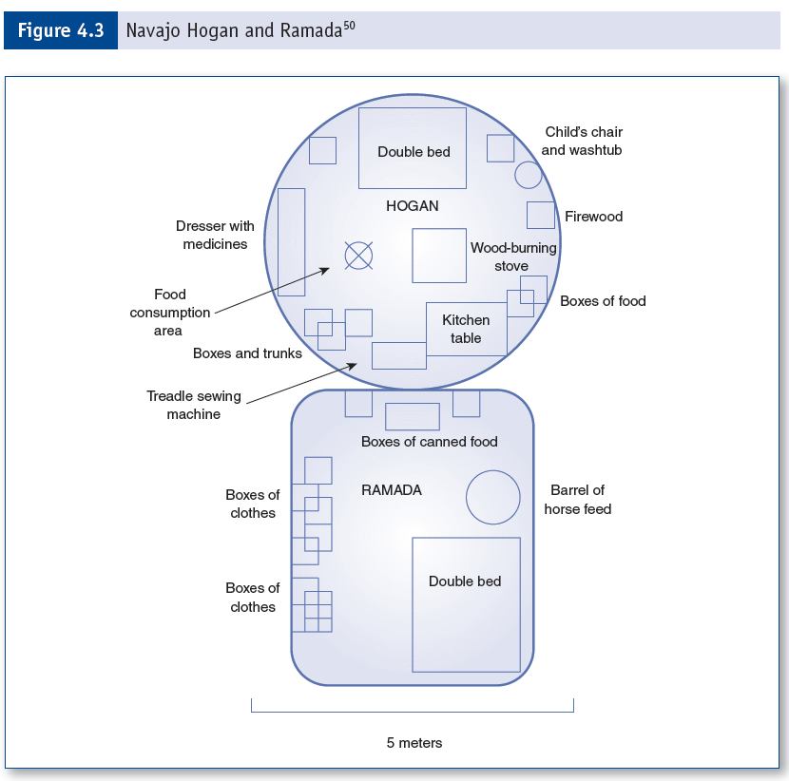
Navajo

