Slide 1
CHAPTER 6
The Sociorelational Context

Slide 2
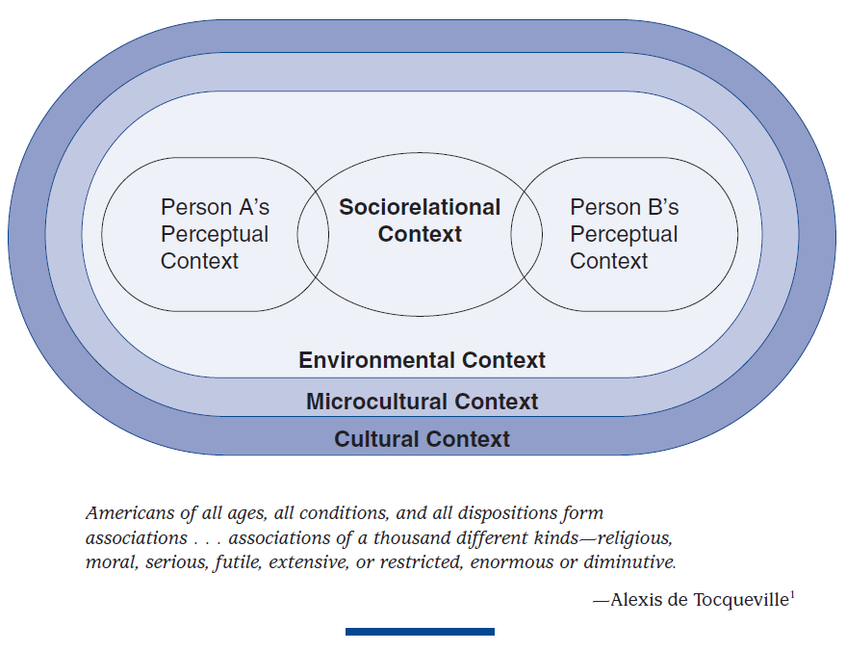
All human beings, regardless of culture, belong to groups. When people from different cultures or microcultures interact, their perception and communication is filtered through their group memberships.

Slide 3
Involuntary vs. Voluntary Membership Groups
Voluntary membership groups: eg. Political affiliation, occupation, religion, etc.
Involuntary membership groups: age, race, sex, biological family, etc.

Slide 4
In-groups vs Out-groups
In-group—a group characterized by internal cohesiveness, whose norms, aspirations, and values shape the behavior of its members.
Out-group—a group whose attributes are perceived as dissimilar by the in-group.

Slide 5
Reference Groups
A reference group possesses some quality to which we aspire and hence, serve as “reference” for our decisions or behaviors.
Examples of positive reference groups are one’s race and joining a political party.
Examples of negative reference groups may be other’s race and the oppositional political party.

Slide 6
What are “Roles”?
A role is one’s relative position in a group.
A role exist in relationship to other roles in a group.
A role comes with an expected set of verbal and nonverbal behaviors.
Formal roles—well-defined behavioral expectations.
Explicit. Violations can lead to removal from role.
Informal roles—expectations vary greatly.
Implicit. Learn from experience.

Slide 7
Roles and Communication
Social identity: How the society around you see you and hierarchically rank you.
Role differentiation: How much a culture or microculture distinguish among roles.
Role stratification: The rank ordering of roles within a culture.

Slide 8
Family Groups
Typically, the first and most significant socialization influence on a child.
Extended family vs. Nuclear family
Family roles: rank, authority, responsibilities, privileges, etc.

Slide 9
Sex and Gender Roles
Sex is biological: usually male & female
Gender is cultural:
Masculine: What is culturally associated with males.
Feminine: What is culturally associated with females.
Expectations and behaviors associated with masculinity and femininity can vary remarkably across cultures.
Gender role stereotypes.
Deviations from cultural gender role expectation are often negatively sanctioned.

Slide 10
Gender Roles across Cultures
Morocco
Japan
India
Saudi Arabia
Egypt
China
Mexico
Etc.

Slide 11
END

Slide 12
Morocco
Moudawana—personal status code
Minimum age for marriage is 18
Marriage must have mutual consent
Dowries are the responsibility of husband

Slide 13
Japan
Japanese Constitution stipulates all are equal
Younger Japanese have more egalitarian attitudes toward sex roles
Older Japanese have more traditional attitudes toward sex roles
Japanese women continue to sacrifice personal goals for harmony of family, in accordance with collectivism

Slide 14
India
Preamble of the Indian Constitution guarantees equality
Male children seen as a blessing
Continue family name
Economic asset
Female children seen as a burden
Dowry
Less education

Slide 15
Saudi Arabia
Patriarchal
Women cannot: vote or drive.
Must have male permission to: travel, work, study, marry.
Only 5% of the workforce.
Reforms initiated in 2004

Slide 16
Egypt
The 1971 constitution denies discrimination based upon sex.
70% of the population is women and children
Greater proportion of women are illiterate than men
Under law, women are not treated equally

Slide 17
China
Women’s liberation began to advance with establishment of the People’s Republic
1950 Marriage Law abolished feudal forms of marriage
Women discouraged from living alone.
Women tend to want more equal division of domestic work.

Slide 18
Mexico
Average age at marriage:
Women=20 years.
Men=23 years.
The young age reduces higher education pursuits.
Males and females used to have very specific and separate roles, but this is changing.

