Slide 1
CHAPTER 9
Developing Intercultural Relationships

Slide 2
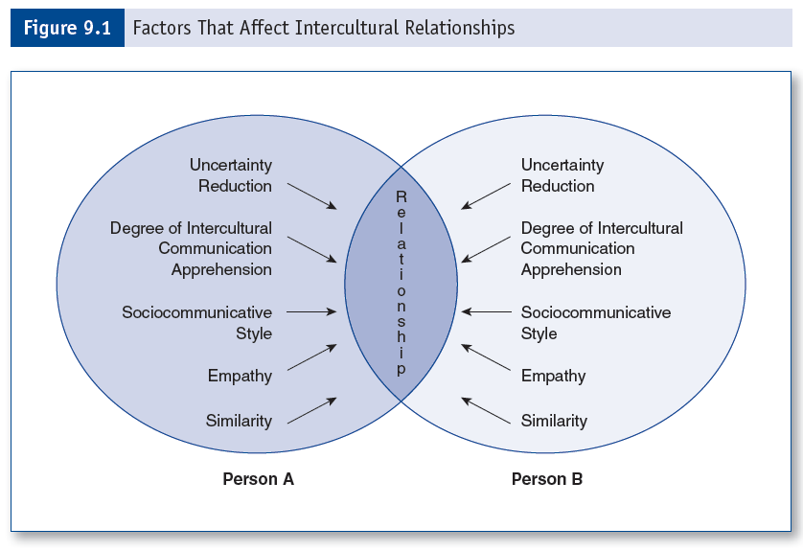
Factors that Affect Intercultural Relationships

Slide 3
Uncertainty Reduction Theory
Premise—the primary goal when interacting with a stranger is to reduce uncertainty and increase predictability of behavior.
Can be:
Proactive—weighing options prior to interactions.
Retroactive—explaining behavior after it occurs.

Slide 4
Anxiety Uncertainty Management Theory
Focuses on managing, rather than reducing, anxiety
Mindfulness—being consciously attentive to incoming information. Actively negotiating meaning, rather than dealing with information in a habitual manner.
Communication effectiveness—is when message interpretation is similar to message intent. The goal of an interaction is to achieve effectiveness.

Slide 5
Socio-Communicative Orientation
Assertiveness—an individual’s ability to make requests, actively disagree, and express positive or negative personal rights and feelings.
Responsiveness—an individual’s ability to be sensitive to the communication of others, including providing feedback, engaging in comforting communication, and listening.

Slide 6
Empathy
Empathy is the degree to which we can accurately infer another’s thoughts or feelings.
Empathy is crucial to intercultural relationships because of the cultural differences between the two individuals.
Model of relational empathy-when two people interact, they create a third culture of shared meaning and relational empathy.

Slide 7
Empathetic Listening Practices:
Paraphrase
Reflect feelings
Reflect meanings
Summarizing

Slide 8
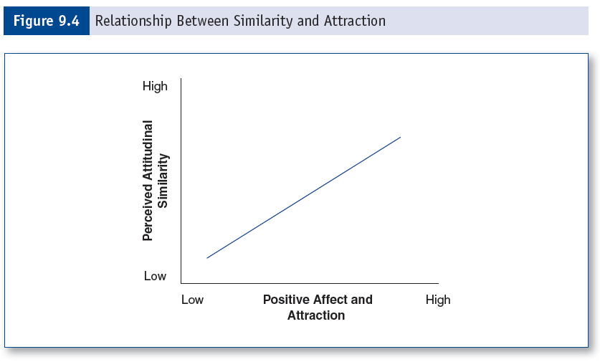
Similarity and Attraction

Slide 9
Eastern Relationships Practice:
Particularism: A particular set of rules apply to each relationship.
Long-term and asymmetrical reciprocity.
Distinct differences between in-group and out-group members.
Use of intermediaries.
Blending of personal and public relationships.

Slide 10
Relationship Types
Serial monogamy
Polygamy (marriage to more than one spouse)
Polygyny (man with multiple wives)
Polyandry (woman with multiple husbands)
Interracial marriages
Account for 2% of U.S. married couples

Slide 11
Relational Maintenance
Self-disclosure
Relationship talk
Positivity
Understanding
Assurances
Networks
Tasks

Slide 12
Mate Selection
Desirability enhancement effect
Desirability diminution effect
Different perspectives of mate selection:
Evolutionary biologists
Sociologists
Geneticists
Social Psychologists

Slide 13
International Mate Selection Project
Characteristics individuals value in mates:
Kindness
Intelligence
Exciting personality
Healthy
Similarities and differences in countries:
Most polarizing characteristic=chastity

